Slide 1
Data Access Object (DAO) with Python

Slide 2
Data Access Object (DAO) with Python
‹#›
Learning Objectives:
In this presentation, you will explore the Data Access Object (DAO) pattern, and apply the Object-Oriented DAO pattern in Python Database connectivity application.
By the end of this lesson, learners will be able to:
Describe the Design pattern and DAO Design pattern.
Demonstrate the DAO pattern.
Demonstrate how to apply the OOP concept and DAO pattern in Python application.

Slide 3
Table of Contents
2
Overview of Design Pattern
Usage of Design Pattern
Data Access Object Patterns
Data Access Object Pattern Components
Data Access Object - DAO
DAO Design Pattern
The Old Process
The New Process - Applying DAO Pattern and OOP
Example: Applying DAO Pattern and OOP

Slide 4
Overview of Design Pattern
Authors, Erich Gamma, Richard Helm, Ralph Johnson and John Vlissides published a book titled Design Patterns - Elements of Reusable Object-Oriented Software (1994), which initiated the concept of Design Patterns in Software development. The authors are collectively known as Gang of Four (GOF), and according to them, design patterns are primarily based on the following principles of object-oriented design (OOD):
Program to an interface, not an implementation.
Favor object composition over inheritance.
The software/application design pattern is a general, reusable solution to a commonly occurring problem within a given context in software design. It is not a finished design that can be transformed directly into source or machine code. It is a description or template for how to solve a problem that can be used in many different situations.
Design patterns are best practices that programmers can employ to overcome common design difficulties, and are solutions to general problems that software developers faced during software and application development. These solutions were obtained by trial and error by numerous software developers over a substantial period of time.

Slide 5
Usage of Design Pattern
Design Patterns have two main uses in software development:
Common platform for developers.
Design patterns provide standard terminology, and are specific to a particular scenario. For example, a Singleton design pattern signifies the use of a single object so that all developers familiar with a single design pattern will make use of a single object, and can verify that the program is following a single pattern.
Best Practices for developers.
Design patterns have evolved over a long period of time, and they provide best solutions to certain problems faced during software development. Learning these patterns helps inexperienced developers learn software design in a fast and easy way.

Slide 6

Data Access Object Patterns
Introduction
Data Access Object (DAO) is a pattern that provides an abstract interface to some type of database or other persistence mechanism.
DAO Design Pattern is used to separate the data persistence logic into a separate layers. This way, the service remains completely in the dark about how the low-level operations access the database. This is known as the principle of Separation of Logic.
DAO is used to separate low-level data accessing API (like JDBC) or operations from high-level business services or the idea is to abstract or hide the database logic from the business layer.
img src: medium.com
Click here for more information about DAO.

Slide 7
Data Access Object Patterns (continued)
The advantage of using data access objects is the relatively simple and rigorous separation between two important parts of an application that do, but should not know of each other, and which can be expected to evolve frequently and independently.
If we need to change the underlying persistence mechanism, we only have to change the DAO layer, and not all of the places in the domain logic where the DAO layer is used.

Slide 8
Data Access Object Pattern Components
DAO - Data Access Object Interfaces - This interface defines the standard operations performed on the model object(s). The interfaces provide a flexible design.
DAO - Data Access Object classes - This class implements above the interface, and is responsible for getting data from a data source, which can be a database / xml or any other storage mechanism. The interface implementation is a concrete implementation of the persistence logic.
DAL - Data-Access Layer - DAL is made up of interface and implementation classes for DAO. This layer provides easy and simplified access to data stored in persistent storage such as an entity-relational database or any database in applications. This layer is between the service layer and the storage layer.
Model Classes / DTO - This object is simple POJO class containing getter and setter methods to store data retrieved using DAO class.
DataSource: A data source could be a database such as an RDBMS, File,, XML repository, flat file system, or any other data source. A data source can also be another system service or some kind of repository.

Slide 9
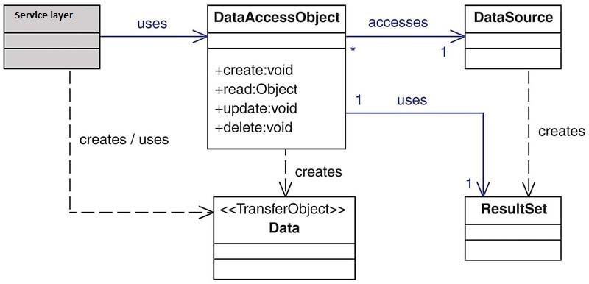
Data Access Object Pattern Components (continued)
High-Level Class Diagram representing the relationships for the DAO Pattern.
Img Source: Per Scholas. 2022
Notes:
Data transfer object(DTO), if multiple requests are required to bring data for a particular task, data to be brought can be combined in a DTO so that only one request can bring all the required data.

Slide 10
Data Access Object - DAO
3
This is the primary object of a DAO design pattern.
DAO is an object that provides an abstract interface to some type of database or any other persistence storage. By mapping the application calls to the persistence layer, the DAO provides some specific data operations without exposing the details of the database.

Slide 11

DAO Design Pattern Workflow
6
Data Access Object
Business
Object
uses
connects
Data
Source
creates / uses
Transfer Object
Source: Per Scholas

Slide 12
The Old Process
8
Repeat for every DAO:
Connect to database – Same every time.
Create cursor – Same every time.
Prepare and issue statement.
Obtain data from database.
Close the connection – Same every time.

Slide 13
The New Process - Applying DAO Pattern and OOP
Start with ConnectionDAO class:
connect() method:
▶ Connect to database.
▶ Create cursor.
close() method:
▶ Close the connection.
Create class for queries.
Create classes for each DAO:
Implement methods:
▶ start with connect method, provide logic, and end with close method.
Create main function:
Create DAO object and call the methods.

Slide 14
Example: Applying DAO Pattern and OOP - Step1: Defining ConnectionDAO Class
Create a python file names “DAOdemo.py”, and add below in it. In this example, we will use “usersdb” database. If you do not have that database, you must create database by the name of “usersdb” in MySQL.
import mysql.connector as dbconnect
class ConnectionDAO:
con = None
cur = None
@classmethod
def connect(cls):
cls.con= dbconnect.connect(host='localhost',database='usersdb',user='root', password='password',port='3306')
cls.cur = cls.con.cursor()
@classmethod
def close(cls):
if not cls.con:
cls.con.close()

Slide 15
Example: Applying DAO Pattern and OOP - Step2: Defining Queries class
In “DAOdemo.py” file add a below code.
class Queries:
create_user_t = "CREATE TABLE user (email VARCHAR (100),name VARCHAR (50),password VARCHAR (30))"
insert_users = "INSERT INTO user(email, name, password) values('Tony@perscholas.org','haseeb','letsgomets'), ('John@perscholas.org','John','iwillnottellyou')"

Slide 16
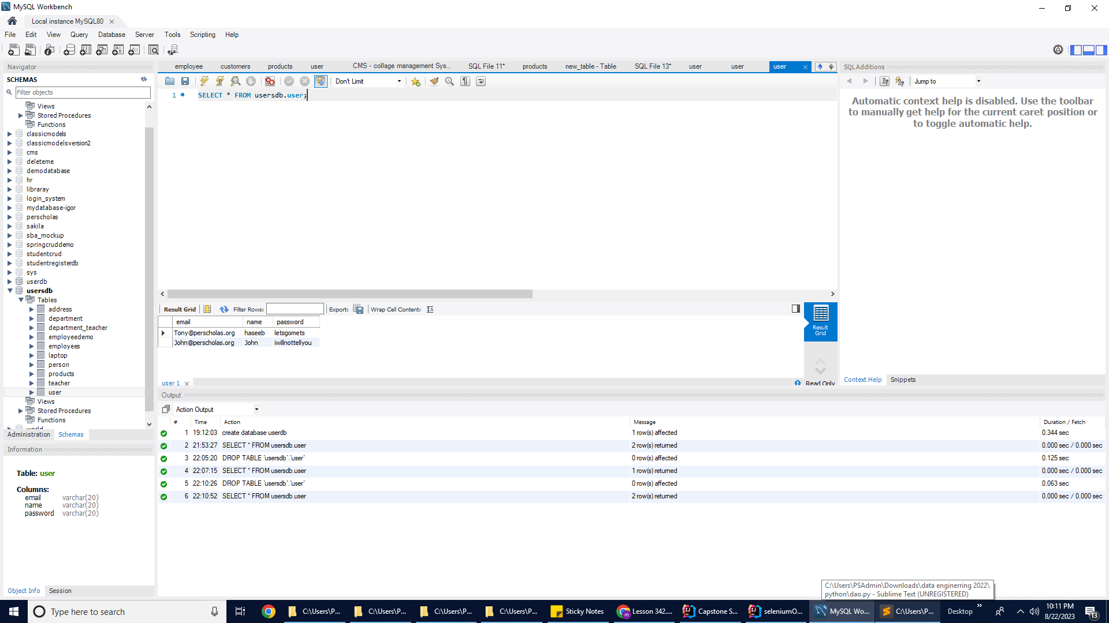
Example: Applying DAO Pattern and OOP - Step 3: Defining UserDAO class and Main() function
In “DAOdemo.py” file add a below code
class UserDAO (ConnectionDAO):
def generate_data(self):
UserDAO.connect()
UserDAO.cur.execute(Queries.create_user_t)
UserDAO.con.commit()
UserDAO.close()
def generate_user_table(self):
UserDAO.connect()
UserDAO.cur.execute(Queries.insert_users)
UserDAO.con.commit()
UserDAO.close()
# invoke the classes
def main():
u = UserDAO()
u.generate_data()
u.generate_user_table()
main()
Result:
After execution the code, user table must create in a database along with two records as shown in a screenshot below:

Slide 17
Exercise: Task for you
13
“User” Table - Applying DAO Pattern and OOP
Starting with the given code, implement the other four methods applying DAO Pattern and OOP:
get_all_users()
get_user_by_name(name)
validate_user(email, password)
update_user(email, name, password)

Slide 18
Exercise: User Table - Applying Transfer Object
14
Modify the current program to use Transfer Object:
Create User class with the instance variables associated with each field in the user table (in MySQL).
Modify the following methods:
▶ get_all_users() should return a list of User objects instead of printing out the values of the current users.
▶ get_user_by_name(name) should return a User object instead of printing out the value of the user.
▶ update_user(user) should take a User object as an argument instead of email, name, and password.
▶ main() should print out the result.

Slide 19
Exercise: User Table - Getting Input
15
Modify the current program for the following requirements:
Modify the main() method to take input from the console when calling the following methods from UserDAO object:
▶ get_user_by_name(name).
▶ validate_user(email, password).
▶ update_user(user).

Slide 20
Exercise: User Table - Further Abstraction
16
Modify the current program for the following requirements:
Create UserRunnable class with the following methods:
▶ generate_user_table().
▶ get_all_users().
▶ get_user_by_name(name).
▶ validate_user(email, password).
▶ update_user(user).
Each method should create a UserDAO object; invoke the appropriate method; take input from console; if necessary; and print out the result.
The main() method should create a UserRunnable object and invoke its methods.

Slide 21
Exercise: User Table - Finishing up
17
Modify the current program for the following requirements:
Within the main() method, rather than invoking all methods, users should be given options to choose so that they can select which query/method they want to call.
*Optional:
insert_user(user) – This method takes a User object as an argument and inserts a row into user table with the values from the object.
delete_table(table_name) – This method removes the table with the given name from the database.

Slide 22
Knowledge Check
What is Design Pattern, and why do we use it?
What is the Data Access Object (DAO) Pattern.
What are the Data Access Object Pattern components.

Slide 23
Glossary/Terminology
DAO: Data Access Object
DTO: Data Transfer Object
DAL: Data: Access Layer
BLL: Business/controller Logic Layer
POJO: Plain Old Java Object
CRUD: Create, Read/Retrieve, Update and Delete
GOF: Gang of Four

Slide 24
Summary Review
18
In 1994, Erich Gamma, Richard Helm, Ralph Johnson, and John Vlissides introduced the concept of Design Patterns in software development through their book "Design Patterns - Elements of Reusable Object-Oriented Software." Collectively known as the Gang of Four (GOF), the authors emphasized key principles of object-oriented design: programming to interfaces and favoring object composition over inheritance. Design patterns are general, reusable solutions for common software design problems, offering best practices that have evolved through trial and error over time.
The Data Access Object (DAO) pattern serves as an abstract interface to database or persistence mechanisms, designed to isolate data persistence logic, separating it into a distinct layer. By employing the DAO pattern, the service layer remains unaware of the specifics of low-level database operations, a concept known as the Separation of Logic principle. Essentially, DAO is instrumental in segregating low-level data access APIs such as JDBC from high-level business services, effectively abstracting the database operations from the business layer.
The key advantage of utilizing data access objects lies in the clear and robust separation of two critical components of an application: the data layer and the business logic layer. These two parts, while interrelated, should not have direct knowledge of each other. Furthermore, this separation allows for independent evolution of each layer. In cases where a change in the underlying persistence mechanism is required, modifications need only be made in the DAO layer, sparing the need for adjustments throughout the domain logic that rely on the DAO layer.

Slide 25

End of Module
20

